Slide 1

Mortality Risk Predictions in Covid-19 Patients using Deep Neural Networks
Hao Hao , Sweta Priyadarshi
ECE Graduate Student
18898 Graph Signal Processing Project

Slide 2

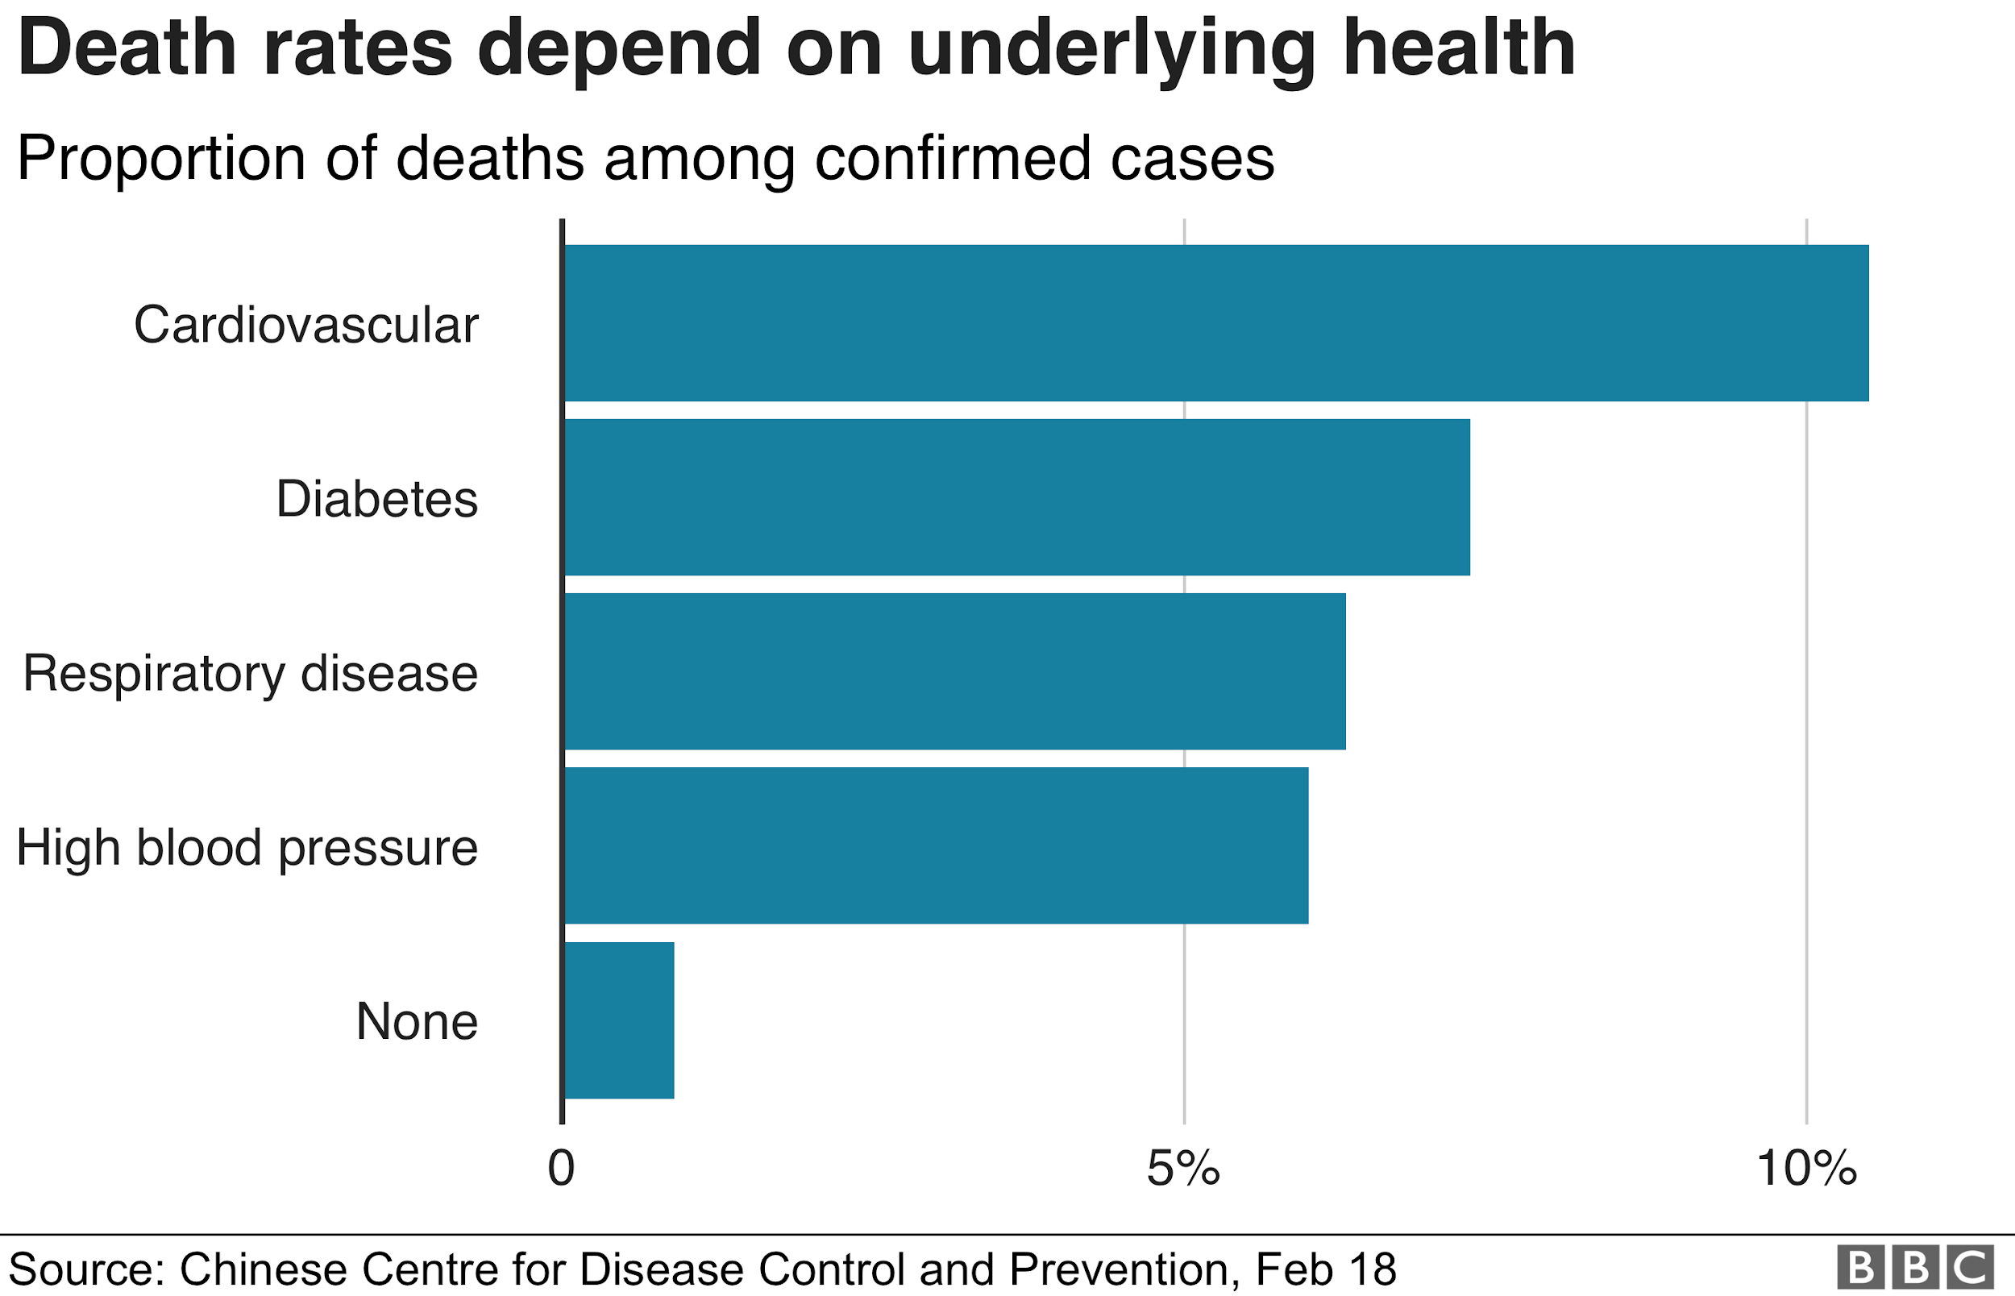
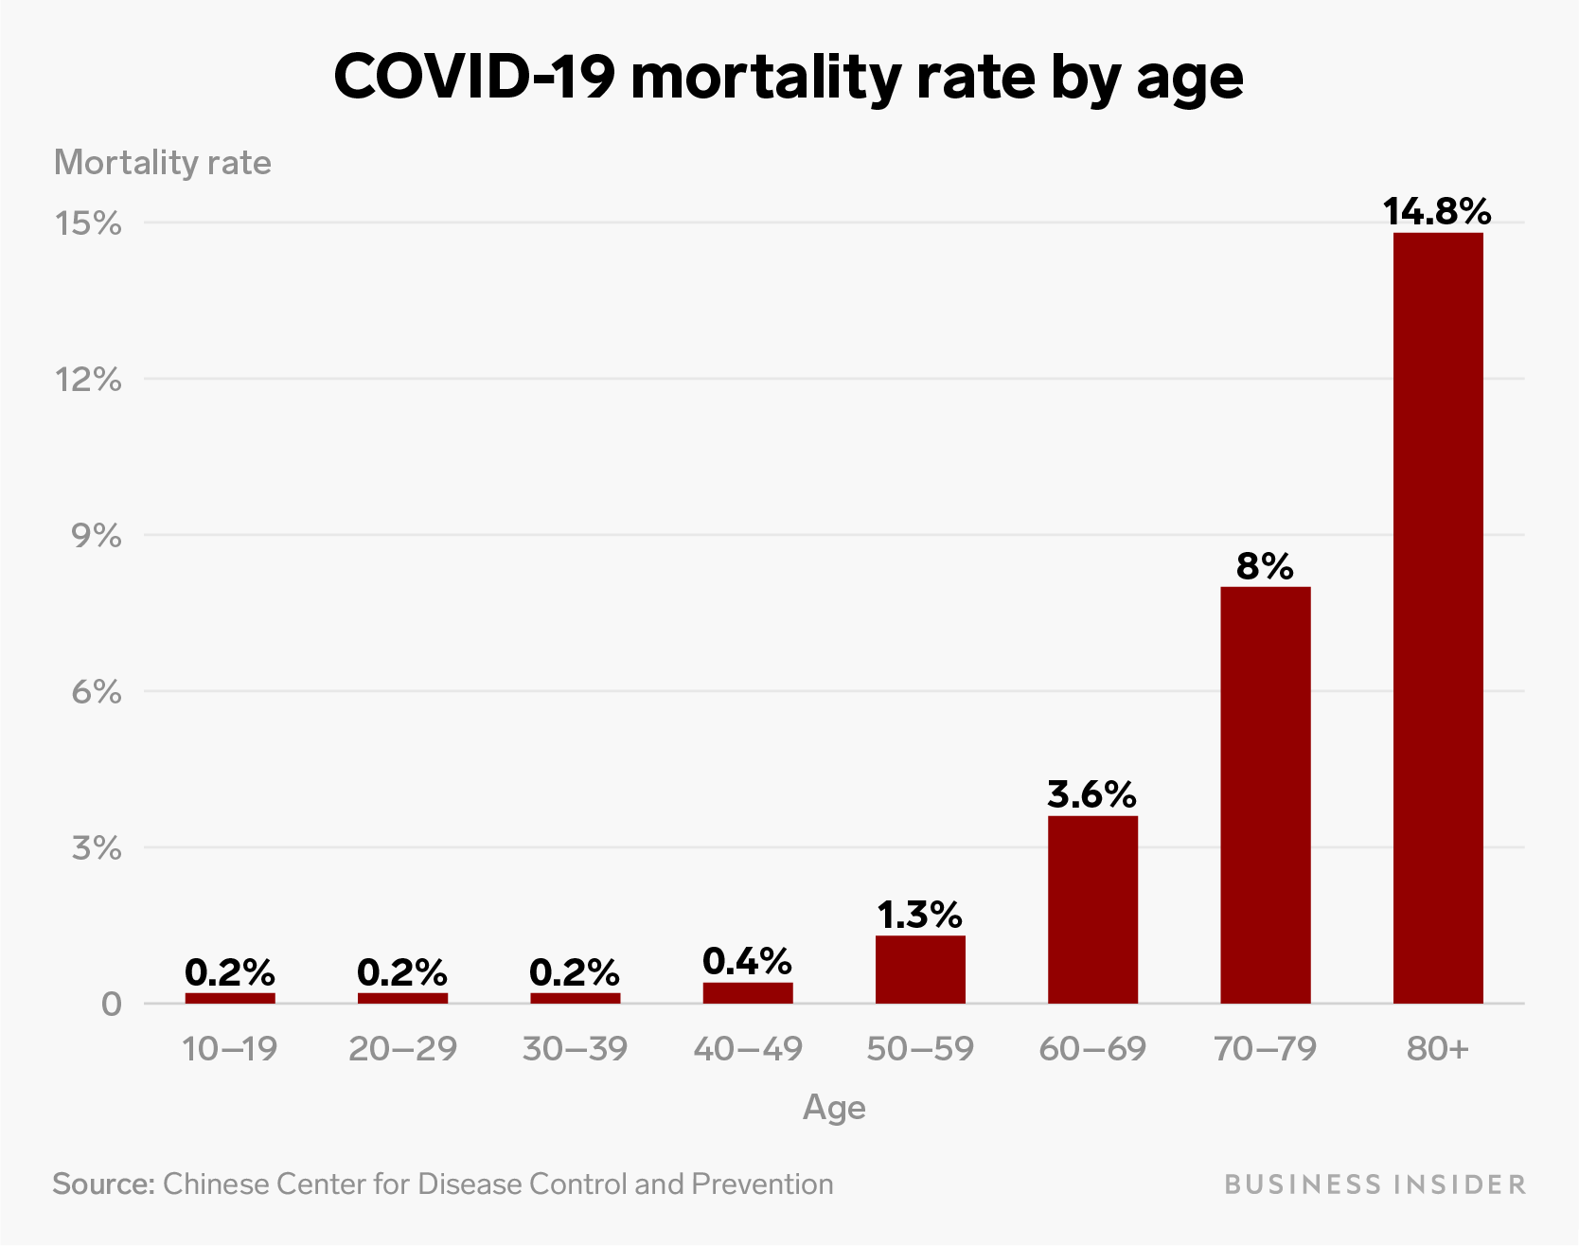
Motivation & Introduction
Covid-19 cases are quite varied ranging from normal cough and recovery to organ failures.
Analysis is needed to better strategize the budget and healthcare resources to different category of patients.
Our task- Classify cases as
Resulting in death / critical condition
Survived
Credits- https://www.eastidahonews.com/2020/05/covid-19-infections-still-rising-albeit-slowly-new-recovery-and-death-stats/
https://www.sciencealert.com/covid-19-s-death-rate-is-higher-than-thought-but-it-should-drop
https://www.bbc.com/news/health-51674743
Notes:
Our motivation came from the fact that the mortality risk varies significantly among different covid-19 patients. This can be seen from the charts (available publicly) that display various factors that affect the mortality risk.
It is difficult to predict which fraction of the patient will need intensive critical support and which fraction just requires quarantine to recover.
As a result, we recognized that it can be valuable to help hospitals identify high-risk patients and prioritize medical resources with precision, especially when the system is overwhelmed.
For this project, we implemented neural networks to predict individual-level mortality risk of confirmed covid-19 patients.
Specifically, we formulated this problem as a classification problem.

Slide 3
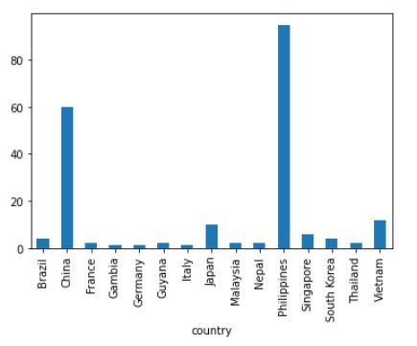
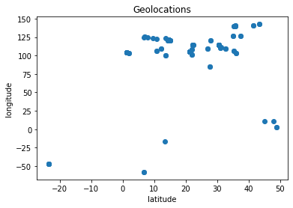
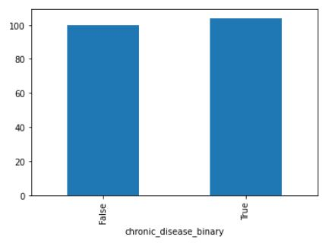
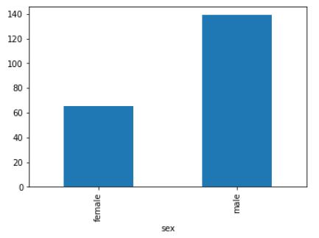
Dataset
The dataset contains 450,000+ confirmed patients/cases from 24 different countries
Dataset includes both male/female patients with an average age of 49.8
Reference:
Xu, B., Gutierrez, B., Mekaru, S., Sewalk, K., Goodwin, L., et al. Epidemiological data from the covid-19 outbreak, real-time case information. Scientific Data, 7(1), 2020. doi:10.1038/s41597-020-0448-0.
Notes:
To start, we processed a dataset that contains more 450 thousand covid-19 patients from 24 different countries
The dataset includes both male/female patients with an average age of 49.8

Slide 4
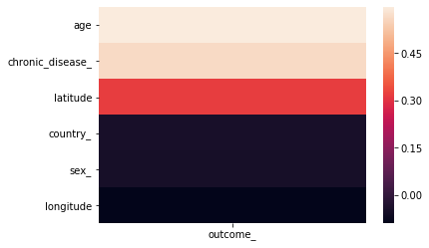
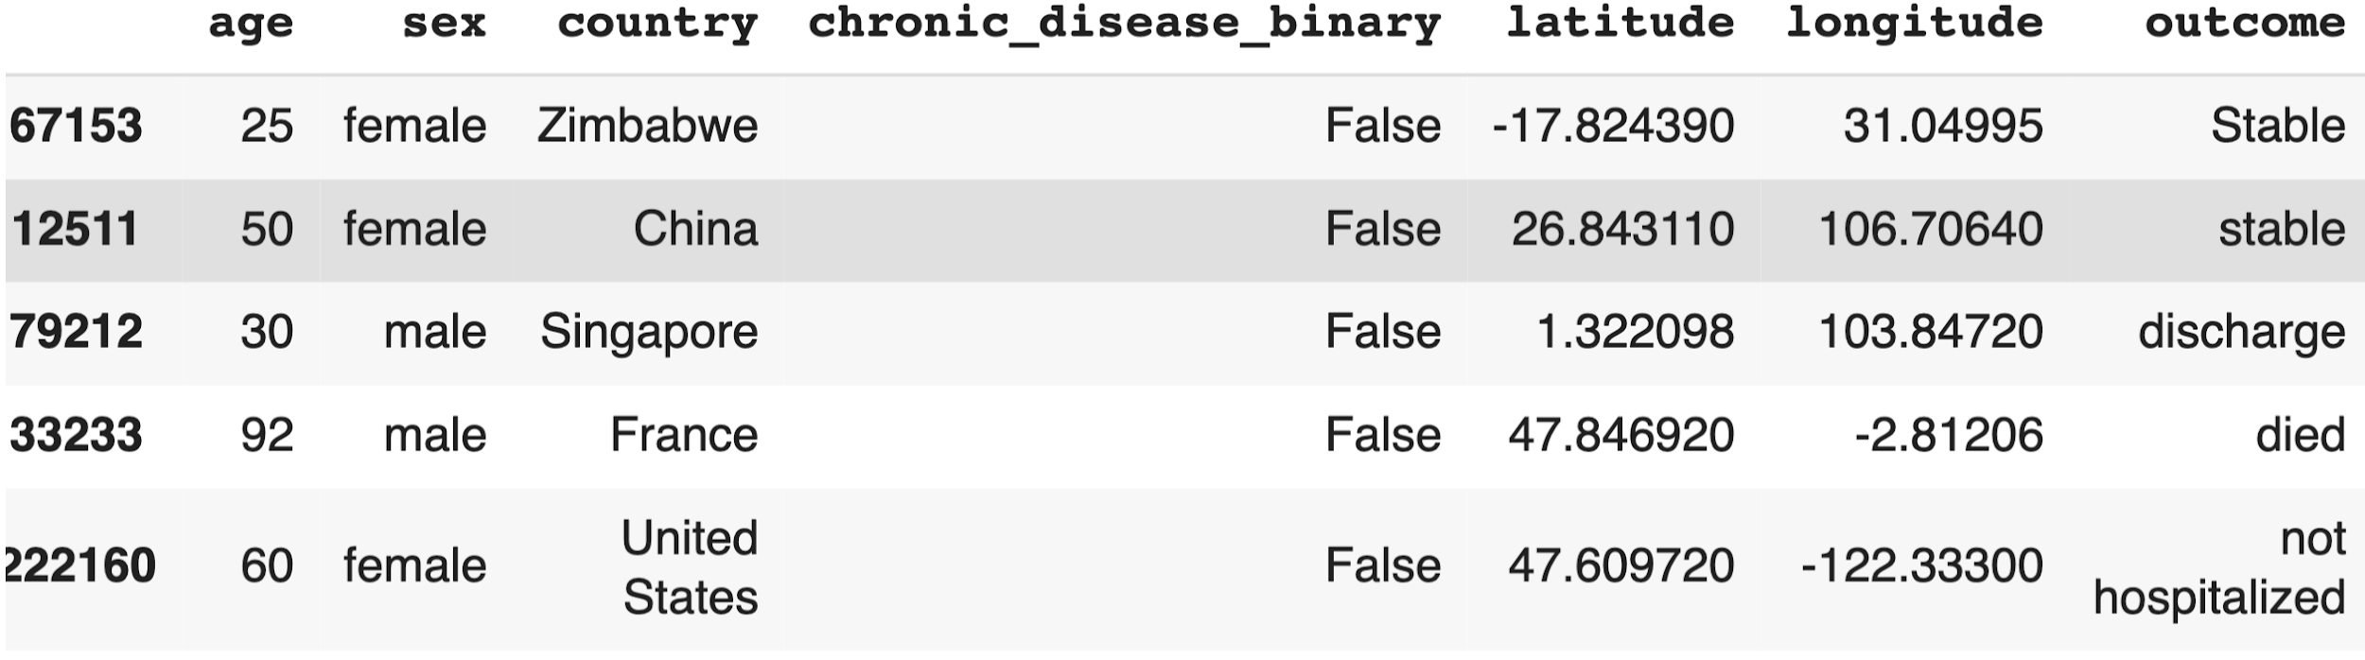
Dataset
Original dataset is highly sparse on a number key features
Removed cases with missing key features.
Processed dataset includes 679 patients
Information includes - age, sex, chronic disease, geographical location and outcome
Age and chronic disease history are the top two factors/features with high correlation to patients’ outcome
Correlation heat map
Reference:
Xu, B., Gutierrez, B., Mekaru, S., Sewalk, K., Goodwin, L., et al. Epidemiological data from the covid-19 outbreak, real-time case information. Scientific Data, 7(1), 2020. doi:10.1038/s41597-020-0448-0.
Notes:
However, the original dataset contains redundant information and is highly sparse on a number key features.
As a result, we removed redundancies and removed the cases with missing key features. And the final dataset includes 679 patients
Each patient’s Information includes - age, sex, chronic disease, geographical location and the final outcome of the patient
We computed the cross-correlation between the features and the outcome. The result shows that age and chronic disease history are the top two factors with high correlation to patients’ outcome.

Slide 5
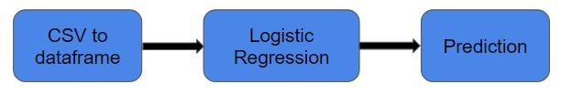
Logistic Regression
It predicts the probability of occurrence of a binary event utilizing a logit function.
The baseline model we tried is the logistic regression to binarize our data and classify them as "dead" or "alive/survived" cases.
The logistic regression model uses sklearn library and uses "accuracy" as the metrics.
Obtained accuracy of upto 91% on test dataset
Pipeline Involved- Data Loading→> Model Training →> Model Evaluation
Notes:
Moving on to our approaches, given a recently confirmed covid-19 case, we wish to learn a discriminative model that predicts the patient’s mortality risk versus survival chance.
We start with a baseline logistic regression model in a binary classification setting. We split the dataset into training/testing set with a 70% to 30% ratio.
Given the training set, the logistic regression model learns the optimal model parameter that minimize the cross-entropy loss, as a result, the model is able to predict the probabilities that a patient will disease or survive.
This baseline model obtained a testing accuracy of 91%.
We then implemented a neural network model to solve the same binary classification problem.

Slide 6
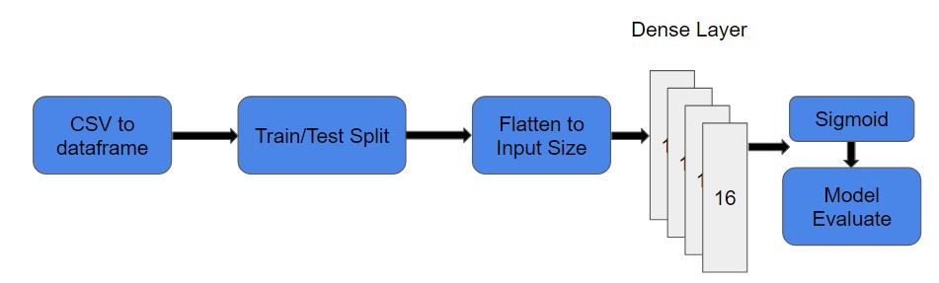
NN for Binary Classification
The implemented network consists three hidden layers each with 16 neurons.
Relu activation function are used in all the layers and the last layer uses Sigmoid activation,
The training is performed with cross-entropy loss along with the stochastic gradient descent optimizer.
Metric used for the NN for binary classification is accuracy.
Model obtained accuracy of 95% on test dataset.

Slide 7
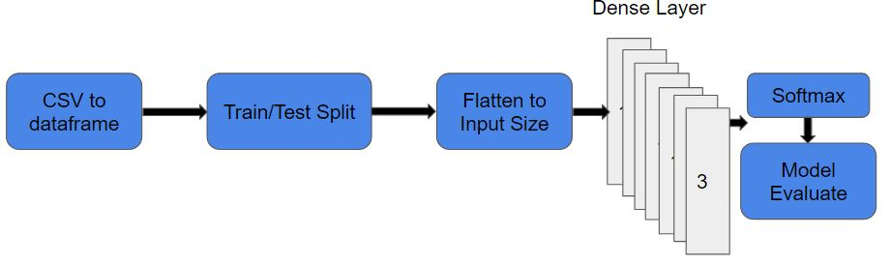
NN for Multi-class Classification
The neural network consists six hidden layers, 32-->>64-->>128-->>64-->>32-->>16 neurons in each layer.
Relu activation function are used in all the layers and the last layer uses softmax activation
The training is performed with kullback-leibler-divergence loss along with the Adam optimizer.
Metric used for the NN for multi-class classification is accuracy.
Model accuracy is 63.45% on test dataset.

Slide 8
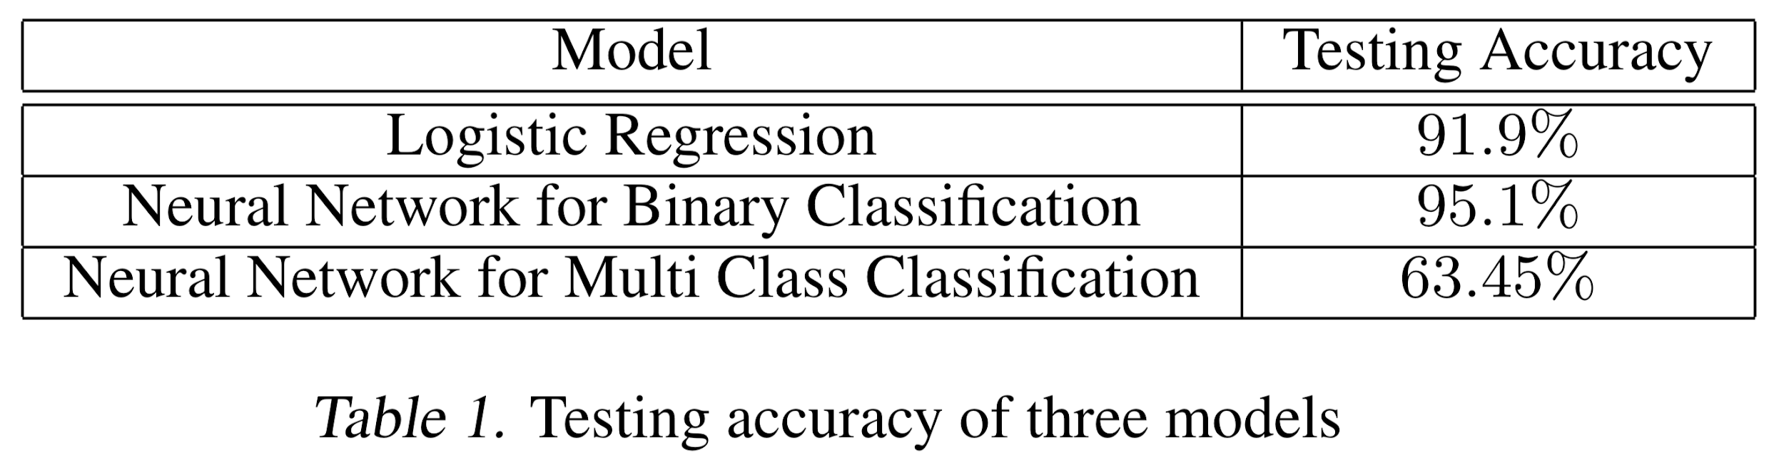
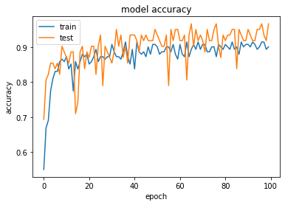
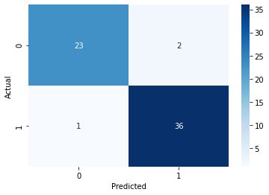
Testing Accuracy of three models
Results
All three predictive models are trained and evaluated on the data set.
The data set is split into random train and test subsets at a 7:3 size ratio.
Neural Network for binary classification: Training and testing accuracy
Neural Network for binary classification: confusion matrix

Slide 9
Conclusion
Performance Report
NN for binary classification > Logistic Regression > NN for multi-class classification
Data non-uniformity results in less accuracy on test dataset in Multi-class Classification neural network.
For multi-class classification the dataset were biased to some class making the prediction accuracy poor.
The future work could include more data collection part along with cleaning to obtain better multi-class classification model.

Slide 10

Questions?

